Slide 1
18
C++ as a Better C; Introducing Object Technology

Slide 2
… no science of behavior can change the essential nature of man …
  Burrhus Frederic Skinner
Nothing can have value without being
an object of utility.
  Karl Marx
The new electronic interdependence recreates the world in the image of a global village.
  Marshall Herbert McLuhan

Slide 3
Knowledge is the conformity of the
object and the intellect.
  Averroës
Many things, having full reference
To one consent, may work contrariously …
  William Shakespeare
A wise skepticism is the first attribute
of a good critic.
  James Russell Lowell

Slide 4
OBJECTIVES
In this chapter you will learn:
Several C++ enhancements to C.
The header files of the C++ Standard Library.
To use inline functions.
To create and manipulate references.
To use default function arguments.
To use the unary scope resolution operator to access a global variable in a scope that contains a local variable of the same name.
To overload function definitions.
To create and use function templates that perform
identical operations on many different types.

Slide 5
18.1 Introduction
18.2 C++
18.3 A Simple Program: Adding Two Integers
18.4 C++ Standard Library
18.5 Header Files
18.6 Inline Functions
18.7 References and Reference Parameters

Slide 6
18.8 Empty Parameter Lists
18.9 Default Arguments
18.10 Unary Scope Resolution Operator
18.11 Function Overloading
18.12 Function Templates
18.13 Introduction to Object Technology and
the UML
18.14 Wrap-Up

Slide 7
18.1 Introduction
The C++ section introduces two additional programming paradigms
  Object-oriented programming
    With classes, encapsulation, objects, operator overloading, inheritance and polymorphism
  Generic programming
    With function templates and class templates
Emphasize “crafting valuable classes” to create reusable software componentry

Slide 8
18.2 C++
C++ improves on many of C’s features and provides object-oriented-programming (OOP) capabilities
  Increase software productivity, quality and reusability
New requirements demand that the language evolve rather than simply be displaced by a new language.
C++ was developed by Bjarne Stroustrup at Bell Laboratories
  Originally called “C with classes”
  The name C++ includes C’s increment operator (++)
    Indicate that C++ is an enhanced version of C
C++ standardized in the United States through the American National Standards Institute (ANSI) and worldwide through the International Standards Organization (ISO)

Slide 9
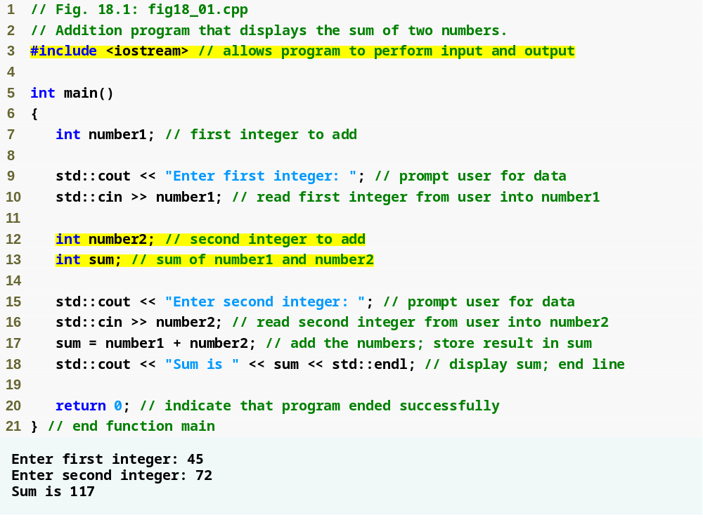
Outline
Include the contents of the iostream
fig18_01.cpp
Declare integer variables
Use stream extraction operator with standard input stream to obtain user input
Stream manipulator std::endl outputs a newline, then “flushes output buffer”
Concatenating, chaining or cascading stream insertion operations

Slide 10
18.3 A Simple Program: Adding Two Integers
C++ file names can have one of several extensions
  Such as: .cpp, .cxx or .C (uppercase)
Commenting
  A // comment is a maximum of one line long
  A /*…*/ C-style comments can be more than one line long
iostream
  Must be included for any program that outputs data to the screen or inputs data from the keyboard using C++-style stream input/output
C++ requires you to specify the return type, possibly void, for all functions
  Specifying a parameter list with empty parentheses is equivalent to specifying a void parameter list in C

Slide 11
Common Programming Error 18.1
Omitting the return type in a C++ function definition is a syntax error.

Slide 12
18.3 A Simple Program: Adding Two Integers (Cont.)
Declarations can be placed almost anywhere in a C++ program
  They must appear before their corresponding variables are used in the program
Input stream object
  std::cin from <iostream>
    Usually connected to keyboard
    Stream extraction operator >>
      Waits for user to input value, press Enter (Return) key
      Stores value in variable to right of operator
        Converts value to variable data type
    Example
      std::cin >> number1;
        Reads an integer typed at the keyboard
        Stores the integer in variable number1

Slide 13
Good Programming Practice 18.1
Always place a blank line between a declaration and adjacent executable statements. This makes the declarations
stand out in the program, enhancing program clarity.

Slide 14
18.3 A Simple Program: Adding Two Integers (Cont.)
Stream manipulator std::endl
  Outputs a newline
  Flushes the output buffer
The notation std::cout specifies that we are using a name (cout ) that belongs to a “namespace” (std)

Slide 15
18.3 A Simple Program: Adding Two Integers (Cont.)
Concatenating stream insertion operations
  Use multiple stream insertion operators in a single statement
    Stream insertion operation knows how to output each type of data
  Also called chaining or cascading
  Example
    std::cout << "Sum is " << number1 + number2
    << std::endl;
      Outputs "Sum is “
      Then, outputs sum of number1 and number2
      Then, outputs newline and flushes output buffer

Slide 16
18.4 C++ Standard Library
C++ programs
  Built from pieces called classes and functions
C++ Standard Library
  Rich collections of existing classes and functions
    Reusable in new applications

Slide 17
Software Engineering Observation 18.1
Use a “building-block” approach to create programs. Avoid reinventing the wheel. Use existing pieces wherever possible. Called software reuse, this practice is central to object-oriented programming.

Slide 18
Software Engineering Observation 18.2
When programming in C++, you typically will use the following building blocks: classes and functions from the C++ Standard Library, classes and functions you and your colleagues create and classes and functions from various popular third-party libraries.

Slide 19
Performance Tip 18.1
Using C++ Standard Library functions and classes instead of writing your own versions can improve program performance, because they are written to perform efficiently. This technique also shortens program development time.

Slide 20
Portability Tip 18.1
Using C++ Standard Library functions and classes instead of writing your own improves program portability, because they are included in every C++ implementation.

Slide 21
18.5 Header Files
C++ Standard Library header files
  Each contains a portion of the Standard Library
    Function prototypes for the related functions
    Definitions of various class types and functions
    Constants needed by those functions
  “Instruct” the compiler on how to interface with library and user-written components
  Header file names ending in .h
    Are “old-style” header files
    Superseded by the C++ Standard Library header files
  Use #include directive to include class in a program

Slide 22
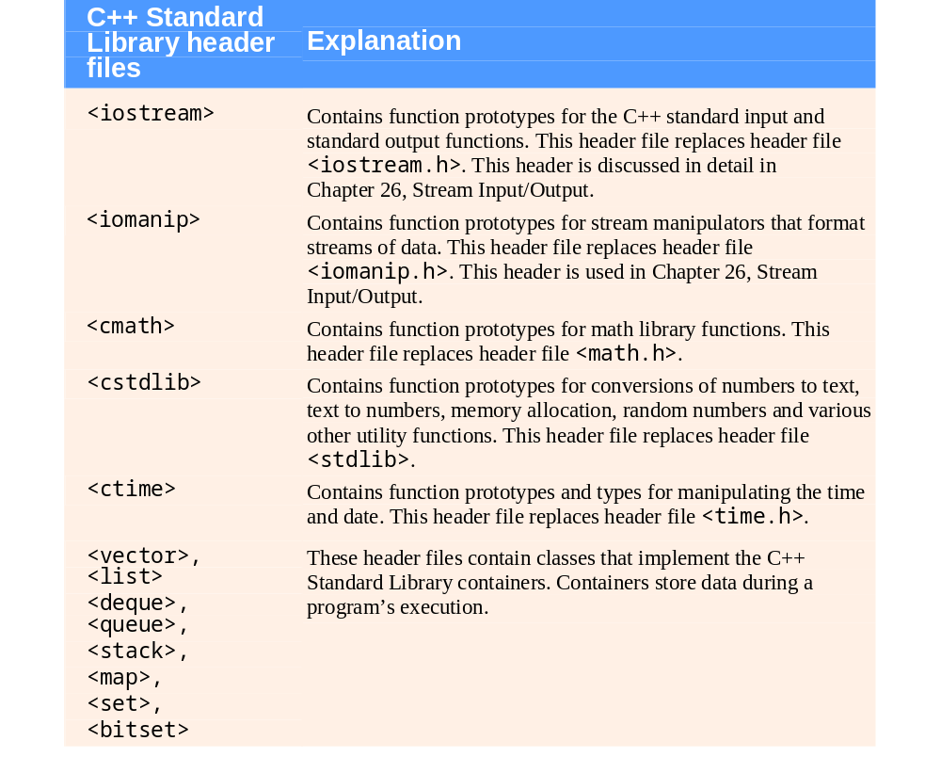
Fig. 18.2 | C++ Standard Library header files. (Part 1 of 3.)

Slide 23
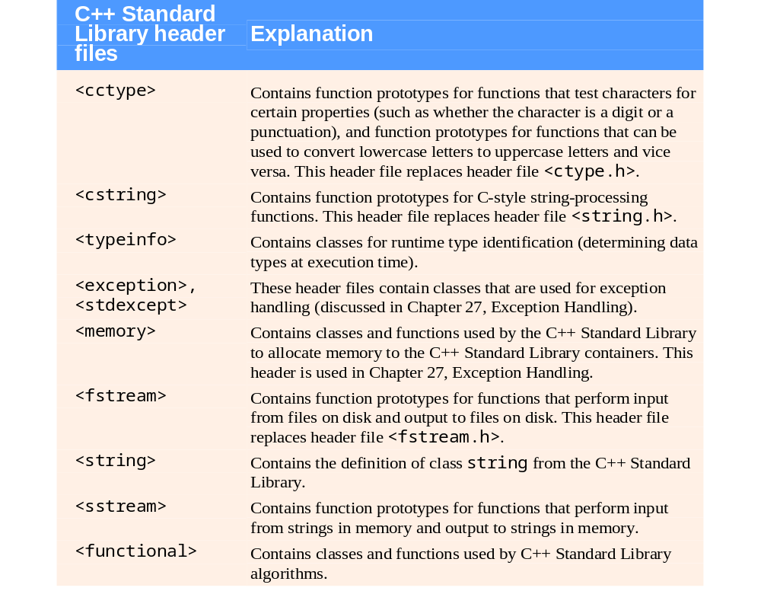
Fig. 18.2 | C++ Standard Library header files. (Part 2 of 3.)

Slide 24
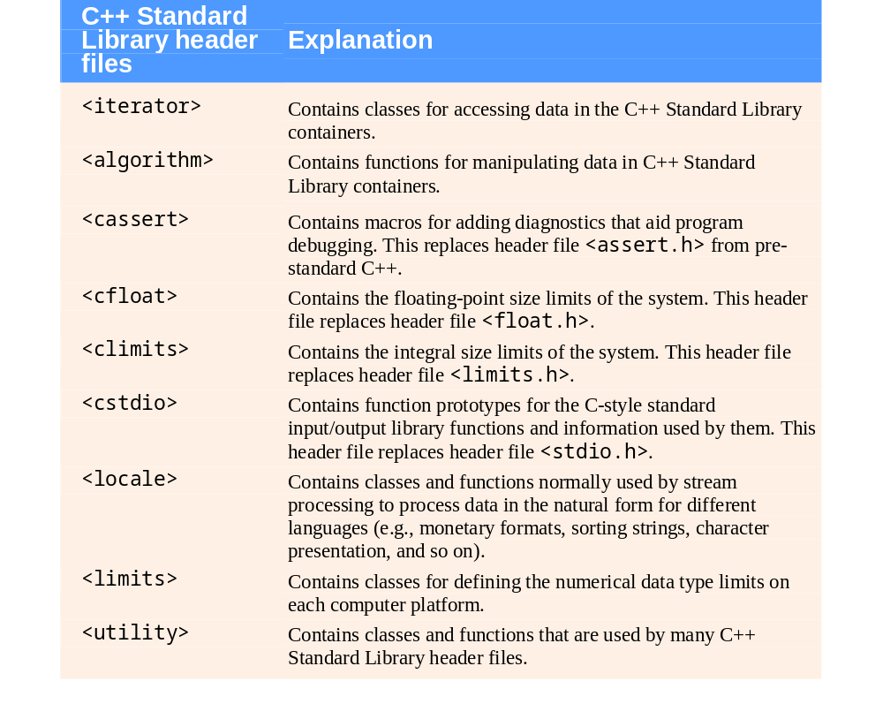
Fig. 18.2 | C++ Standard Library header files. (Part 3 of 3.)

Slide 25
18.6 Inline Functions
Inline functions
  Reduce function call overhead—especially for small functions
  Qualifier inline before a function’s return type in the function definition
    “Advises” the compiler to generate a copy of the function’s code in place (when appropriate) to avoid a function call
  Trade-off of inline functions
    Multiple copies of the function code are inserted in the program (often making the program larger)
  The compiler can ignore the inline qualifier and typically does so for all but the smallest functions

Slide 26
Software Engineering Observation 18.3
Any change to an inline function could require all clients of the function to be recompiled. This can be significant in some program development and maintenance situations.

Slide 27
Performance Tip 18.2
Using inline functions can reduce
execution time but may increase program size.

Slide 28
Software Engineering Observation 18.4
The inline qualifier should be used
only with small, frequently used functions.

Slide 29
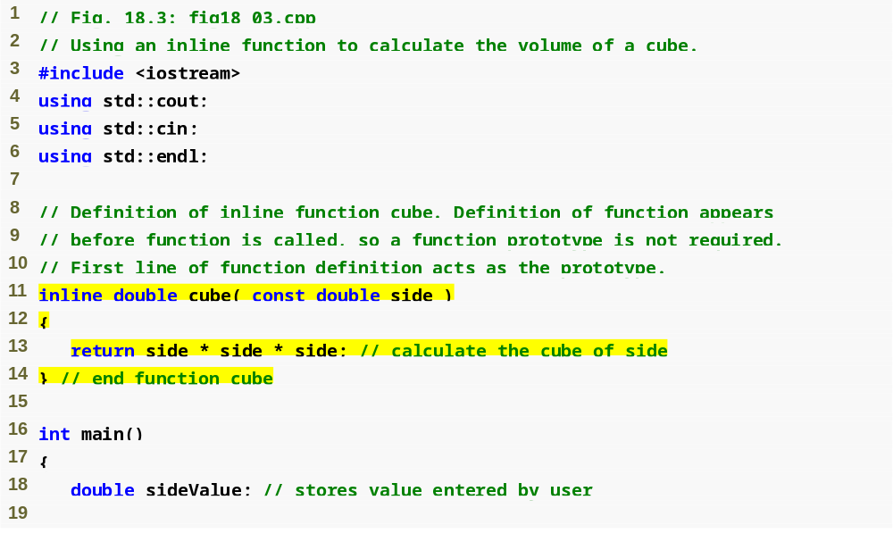
Outline
inline qualifier
fig18_03.cpp
(1 of 2 )
Complete function definition so the compiler knows how to expand a cube function call into its inlined code.

Slide 30
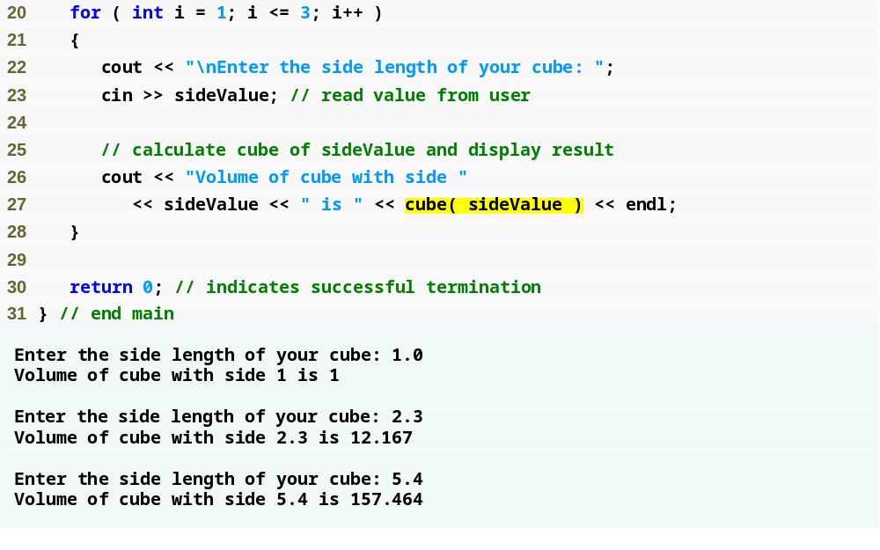
Outline
fig18_03.cpp
(2 of 2 )
cube function call that could be inlined

Slide 31
Software Engineering Observation 18.5
The const qualifier should be used to enforce the principle of least privilege. Using the principle of least privilege to properly design software can greatly reduce debugging time and improper side effects, and can make a program easier to modify and maintain.

Slide 32
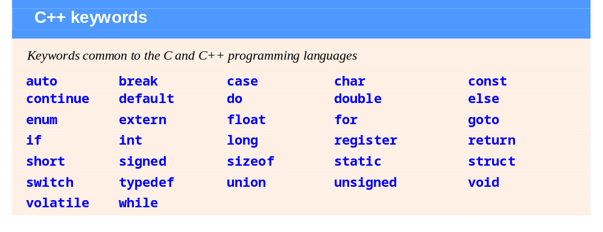
Fig. 18.4 | C++ keywords. (Part 1 of 2.)

Slide 33
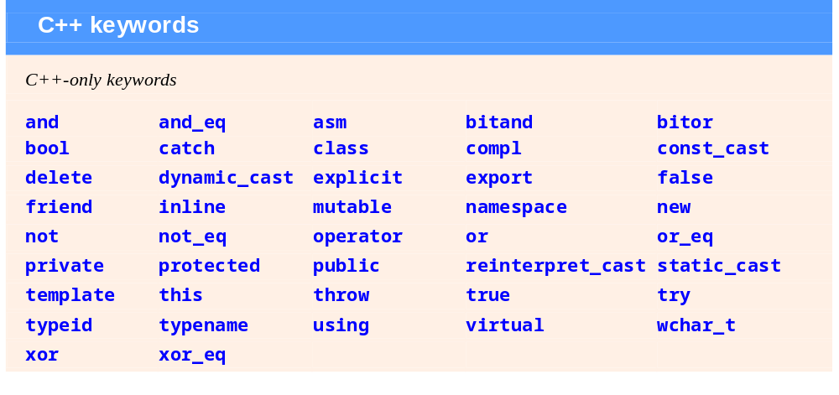
Fig. 18.4 | C++ keywords. (Part 2 of 2.)

Slide 34
18.6 Inline Functions (Cont.)
using statements help eliminate the need to repeat the namespace prefix
  Ex: std::
for statement’s condition evaluates to either 0 (false) or nonzero (true)
  Type bool represents boolean (true/false) values
    The two possible values of a bool are the keywords true and false
      When true and false are converted to integers, they become the values 1 and 0, respectively
      When non-boolean values are converted to type bool, non-zero values become true, and zero or null pointer values become false

Slide 35
18.7 References and Reference Parameters
Two ways to pass arguments to functions
  Pass-by-value
    A copy of the argument’s value is passed to the called function
    Changes to the copy do not affect the original variable’s value in the caller
      Prevents accidental side effects of functions
  Pass-by-reference
    Gives called function the ability to access and modify the caller’s argument data directly

Slide 36
Performance Tip 18.3
One disadvantage of pass-by-value is that, if a large data item is being passed, copying that data can take a considerable amount of execution time and memory space.

Slide 37
18.7 References and Reference Parameters (Cont.)
Reference Parameter
  An alias for its corresponding argument in a function call
  & placed after the parameter type in the function prototype and function header
  Example
    int &count in a function header
      Pronounced as “count is a reference to an int”
  Parameter name in the body of the called function actually refers to the original variable in the calling function

Slide 38
Performance Tip 18.4
Pass-by-reference is good for performance reasons, because it can eliminate the
pass-by-value overhead of copying large amounts of data.

Slide 39
Software Engineering Observation 18.6
Pass-by-reference can weaken security, because the called function can corrupt
the caller’s data.

Slide 40
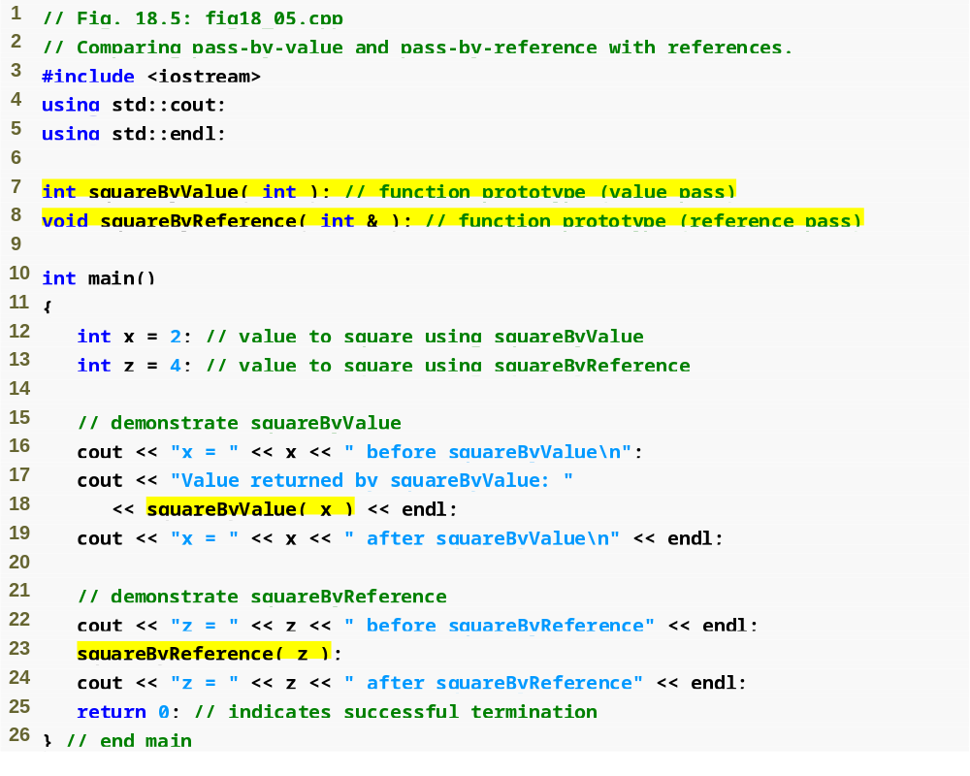
Outline
Function illustrating pass-by-value
fig18_05.cpp
(1 of 2 )
Function illustrating pass-by-reference
Variable is simply mentioned by name in both function calls

Slide 41
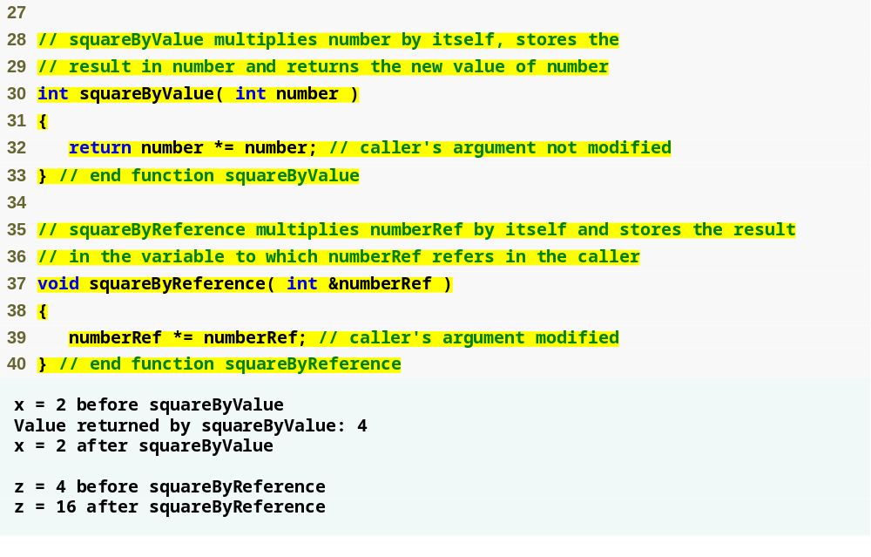
Outline
Receives copy of argument in main
fig18_05.cpp
(2 of 2 )
Receives reference to argument in main
Modifies variable in main

Slide 42
Common Programming Error 18.2
Because reference parameters are mentioned only by name in the body of the called function, the programmer might inadvertently treat reference parameters as pass-by-value parameters. This can cause unexpected side effects if the original copies of the variables are changed by the function.

Slide 43
Performance Tip 18.5
For passing large objects efficiently, use a constant reference parameter to simulate the appearance and security of pass-by-value and avoid the overhead of passing a copy of the large object. The called function will not be able to modify the object in the caller.

Slide 44
Software Engineering Observation 18.7
Many programmers do not bother to declare parameters passed by value as const, even when the called function should not be modifying the passed argument. Keyword const in this context would protect only a copy of the original argument, not the original argument itself, which when passed by value is safe from modification by the called function.

Slide 45
Software Engineering Observation 18.8
For the combined reasons of clarity and performance, many C++ programmers prefer that modifiable arguments be passed to functions by using pointers, small nonmodifiable arguments be passed by value and large nonmodifiable arguments be passed by using references to constants.

Slide 46
18.7 References and Reference Parameters (Cont.)
References
  Can also be used as aliases for other variables within a function
    All operations supposedly performed on the alias (i.e., the reference) are actually performed on the original variable
    An alias is simply another name for the original variable
    Must be initialized in their declarations
      Cannot be reassigned afterward
  Example
    int count = 1;
    int &cRef = count;
    cRef++;
      Increments count through alias cRef

Slide 47
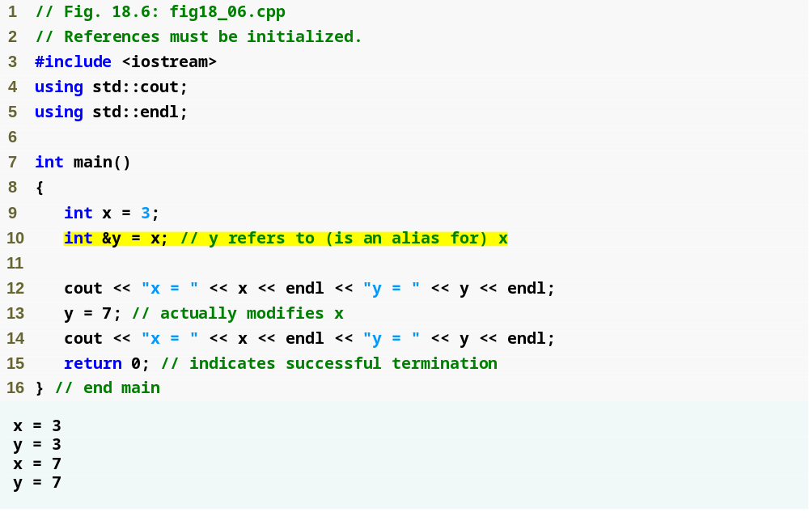
Outline
fig18_06.cpp
Creating a reference as an alias to another variable in the function
Assign 7 to x through alias y

Slide 48
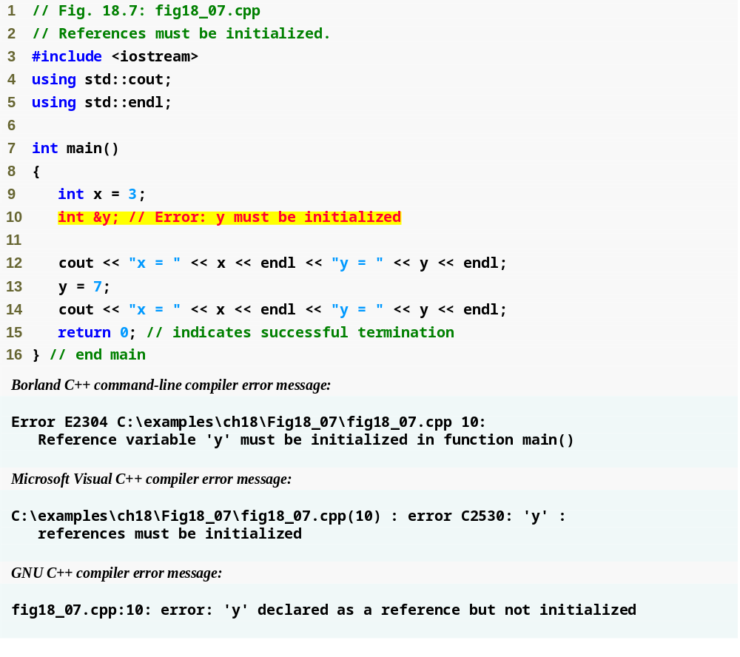
Outline
fig18_07.cpp
Uninitialized reference

Slide 49
18.7 References and Reference Parameters (Cont.)
Returning a reference from a function
  Functions can return references to variables
    Should only be used when the variable is static
  Dangling reference
    Returning a reference to an automatic variable
      That variable no longer exists after the function ends

Slide 50
Common Programming Error 18.3
Not initializing a reference variable when it is declared is a compilation error, unless the declaration is part of a function’s parameter list. Reference parameters are initialized when the function in which they are declared is called.

Slide 51
Common Programming Error 18.4
Attempting to reassign a previously declared reference to be an alias to another variable is a logic error. The value of the other variable is simply assigned to the variable for which the reference is already an alias.

Slide 52
Common Programming Error 18.5
Returning a reference to an automatic variable in a called function is a logic error. Some compilers issue a warning when this occurs.

Slide 53
18.8 Empty Parameter Lists
Empty parameter list
  Specified by writing either void or nothing at all in parentheses
  For example:
  void print();
  void print(void);
  Specifies that function print does not take arguments and does not return a value

Slide 54
Portability Tip 18.2
The meaning of an empty function parameter list in C++ is dramatically different than in C. In C, it means all argument checking is disabled (i.e., the function call can pass any arguments it wants). In C++, it means that the function explicitly takes no arguments. Thus, C programs using this feature might cause compilation errors when compiled in C++.

Slide 55
18.9 Default Arguments
Default argument
  A default value to be passed to a parameter
    Used when the function call does not specify an argument for that parameter
  Must be the rightmost argument(s) in a function’s parameter list
  Should be specified with the first occurrence of the function name
    Typically the function prototype

Slide 56
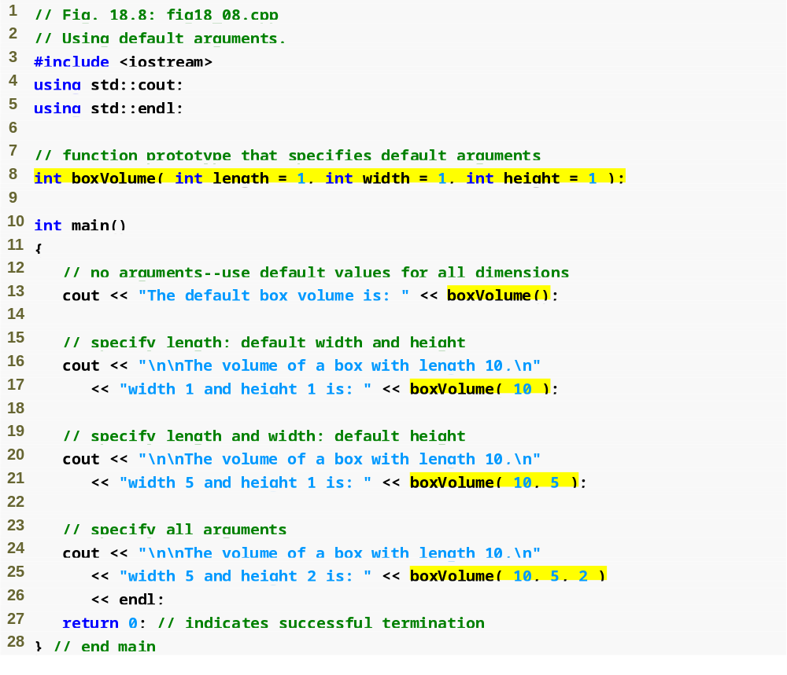
Outline
fig18_08.cpp
(1 of 2 )
Default arguments
Calling function with no arguments
Calling function with one argument
Calling function with two arguments
Calling function with three arguments

Slide 57
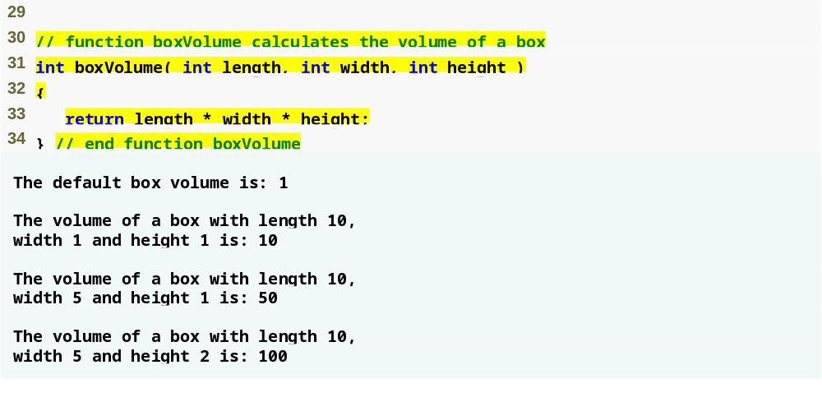
Outline
fig18_08.cpp
(2 of 2 )
Note that default arguments were specified in the function prototype, so they are not specified in the function header

Slide 58
Common Programming Error 18.6
It is a compilation error to specify default arguments in both a function’s prototype and header.

Slide 59
Good Programming Practice 18.2
Using default arguments can simplify writing function calls. However, some programmers feel that explicitly specifying all arguments is clearer.

Slide 60
Software Engineering Observation 18.9
If the default values for a function change,
all client code using the function must be recompiled.

Slide 61
Common Programming Error 18.7
In a function definition, specifying and attempting to use a default argument that is not a rightmost (trailing) argument (while not simultaneously defaulting all the rightmost arguments) is a syntax error.

Slide 62
18.10 Unary Scope Resolution Operator
Unary scope resolution operator (::)
  Used to access a global variable when a local variable of the same name is in scope
  Cannot be used to access a local variable of the same name in an outer block

Slide 63
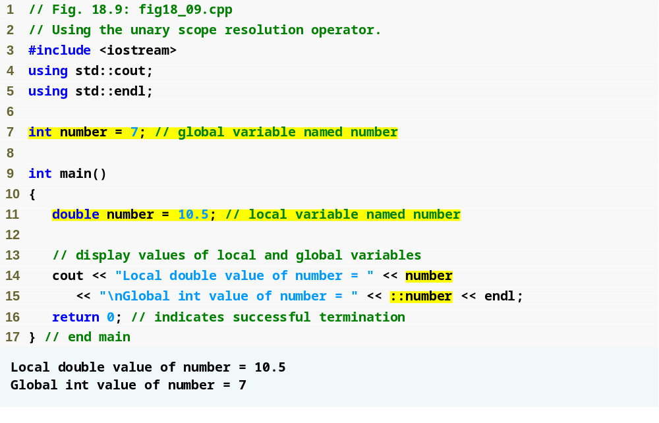
Outline
fig18_09.cpp
Unary scope resolution operator used to access global variable number

Slide 64
Common Programming Error 18.8
It is an error to attempt to use the unary scope resolution operator (::) to access a nonglobal variable in an outer block. If no global variable with that name exists, a compilation error occurs. If a global variable with that name exists, this is a logic error, because the program will refer to the global variable when you intended to access the nonglobal variable in the outer block.

Slide 65
Good Programming Practice 18.3
Always using the unary scope resolution operator (::) to refer to global variables makes programs easier to read and understand, because it makes it clear that you intend to access a global variable rather than a nonglobal variable.

Slide 66
Software Engineering Observation 18.10
Always using the unary scope resolution operator (::) to refer to global variables makes programs easier to modify by reducing the risk of name collisions with nonglobal variables.

Slide 67
Error-Prevention Tip 18.1
Always using the unary scope resolution operator (::) to refer to a global variable eliminates possible logic errors that might occur if a nonglobal variable hides the global variable.

Slide 68
Error-Prevention Tip 18.2
Avoid using variables of the same name for different purposes in a program. Although this is allowed in various circumstances, it can lead to errors.

Slide 69
18.11 Function Overloading
Overloaded functions
  Overloaded functions have
    Same name
    Different sets of parameters
  Compiler selects proper function to execute based on number, types and order of arguments in the function call
  Commonly used to create several functions of the same name that perform similar tasks, but on different data types

Slide 70
Good Programming Practice 18.4
Overloading functions that perform closely related tasks can make programs more readable and understandable.

Slide 71
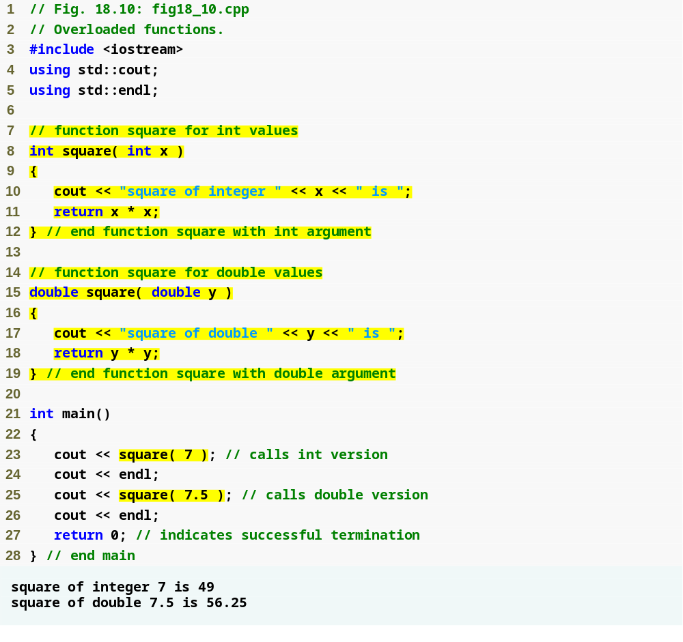
Outline
fig18_10.cpp
Defining a square function for ints
Defining a square function for doubles
Output confirms that the proper function was called in each case

Slide 72
18.11 Function Overloading (Cont.)
How the compiler differentiates overloaded functions
  Overloaded functions are distinguished by their signatures
    Signature is a combination of a function’s name and its parameter types (in order)
  Name mangling or name decoration
    Compiler encodes each function identifier with the number and types of its parameters to enable type-safe linkage
  Type-safe linkage ensures that
    Proper overloaded function is called
    Types of the arguments conform to types of the parameters

Slide 73
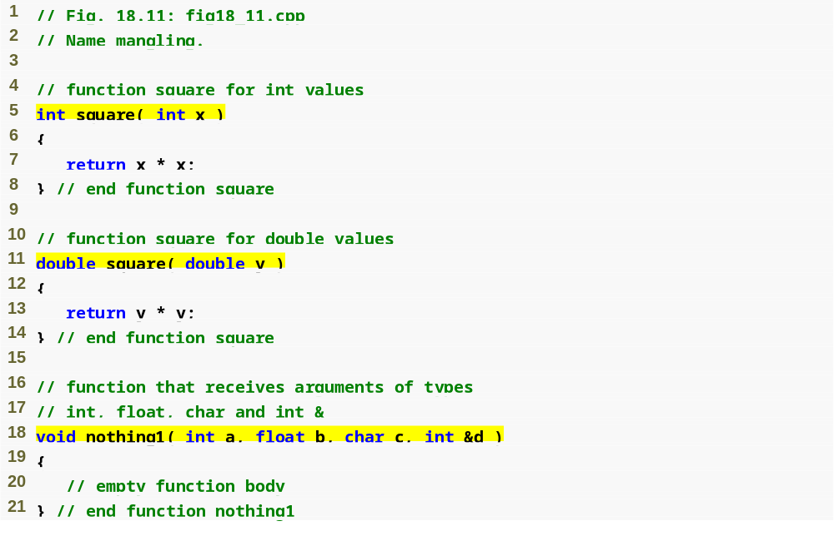
Outline
fig18_11.cpp
(1 of 2 )
Overloaded square functions

Slide 74
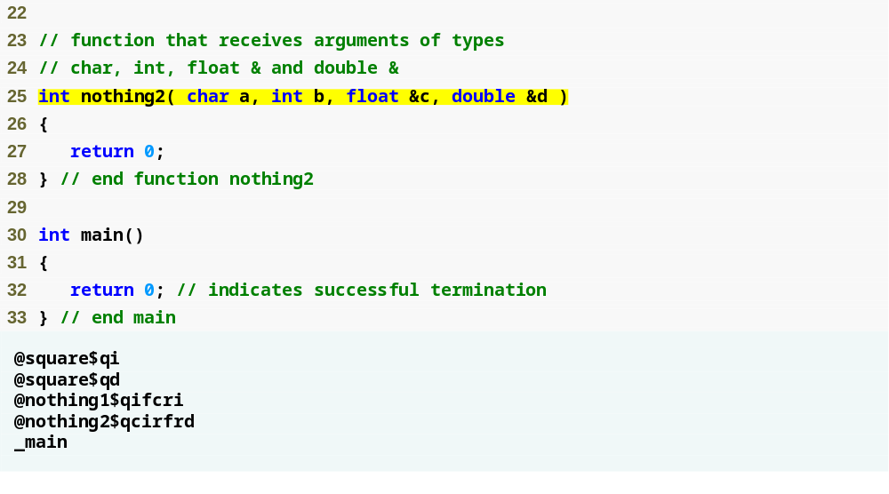
Outline
fig18_11.cpp
(2 of 2 )
Mangled names of overloaded functions
main is not mangled because it cannot be overloaded

Slide 75
Common Programming Error 18.9
Creating overloaded functions with identical parameter lists and different return types is a compilation error.

Slide 76
Common Programming Error 18.10
A function with default arguments omitted might be called identically to another overloaded function; this is a compilation error. For example, having in a program both a function that explicitly takes no arguments and a function of the same name that contains all default arguments results in a compilation error when an attempt is made to use that function name in a call passing no arguments. The compiler does not know which version of the function to choose.

Slide 77
18.12 Function Templates
Function templates
  More compact and convenient form of overloading
    Identical program logic and operations for each data type
  Function template definition
    Written by programmer once
    Essentially defines a whole family of overloaded functions
    Begins with the template keyword
    Contains template parameter list of formal type parameters for the function template enclosed in angle brackets (<>)
    Formal type parameters
      Preceded by keyword typename or keyword class
      Placeholders for fundamental types or user-defined types

Slide 78
18.12 Function Templates(Cont.)
Function-template specializations
  Generated automatically by the compiler to handle each type of call to the function template
  Example for function template max with type parameter T called with int arguments
    Compiler detects a max invocation in the program code
    int is substituted for T throughout the template definition
    This produces function-template specialization max< int >

Slide 79
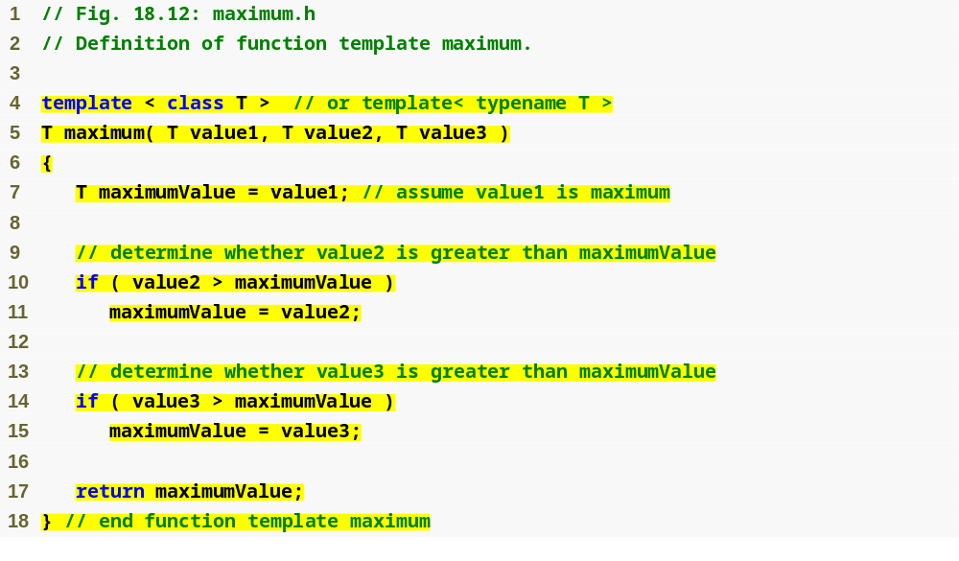
Outline
Using formal type parameter T in place of data type
maximum.h

Slide 80
Common Programming Error 18.11
Not placing keyword class or keyword typename before every formal type parameter of a function template (e.g., writing < class S, T > instead of < class S, class T >) is a syntax error.

Slide 81
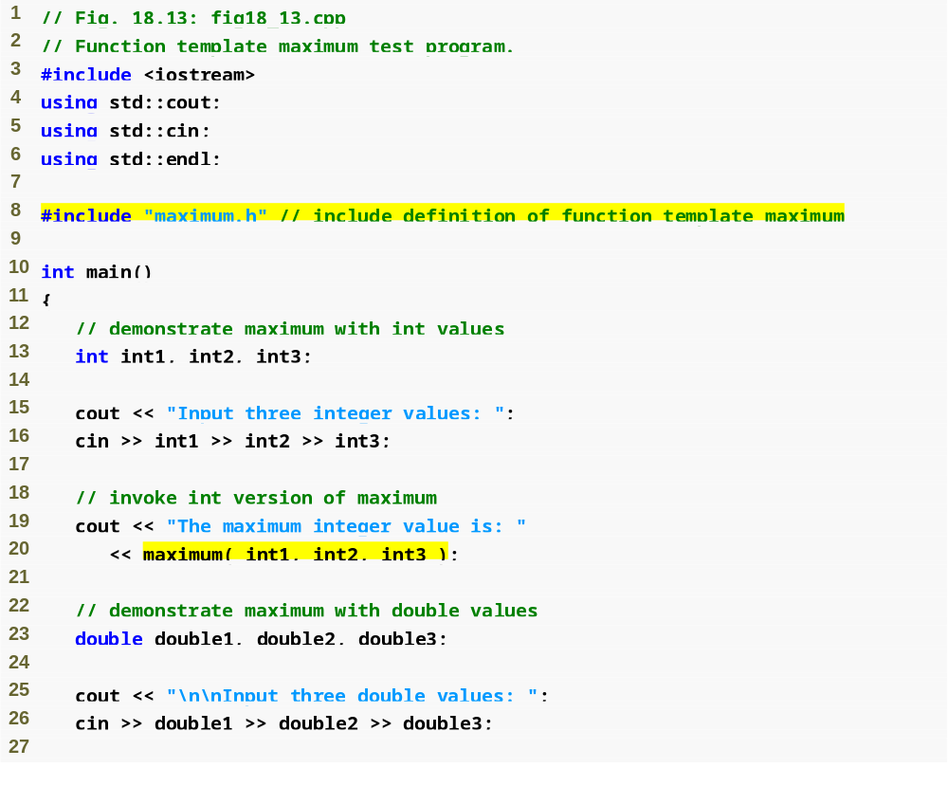
Outline
fig18_13.cpp
(1 of 2 )
Invoking maximum with int arguments

Slide 82
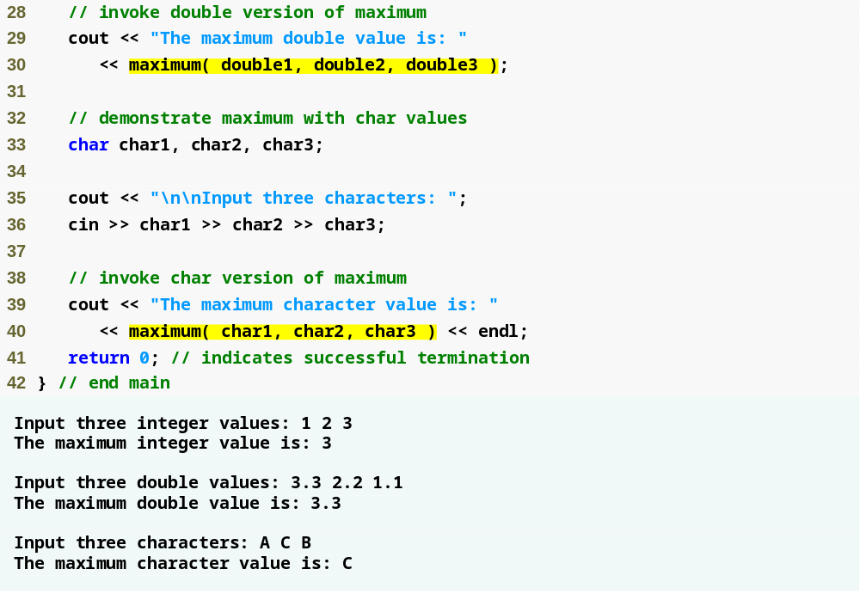
Invoking maximum with double arguments
Outline
fig18_13.cpp
(2 of 2 )
Invoking maximum with char arguments

Slide 83
18.13 Introduction to Object Technology and the UML
Object orientation
  A natural way of thinking about the world and computer programs
Unified Modeling Language (UML)
  Graphical language that uses common notation
  Allows developers to represent object-oriented designs

Slide 84
18.13 Introduction to Object Technology and the UML (Cont.)
Objects
  Reusable software components that model real-world items
  Examples are all around you
    People, animals, cars, telephones, microwave ovens, etc.
  Have attributes
    Size, shape, color, weight, etc.
  Exhibit behaviors
    Babies cry, crawl, sleep, etc.; cars accelerate, brake, turn, etc.

Slide 85
18.13 Introduction to Object Technology and the UML (Cont.)
Object-oriented design (OOD)
  Models real-world objects in software
  Models communication among objects
  Encapsulates attributes and operations (behaviors)
    Information hiding
    Communication through well-defined interfaces
Object-oriented language
  Programming in object oriented languages is called object-oriented programming (OOP)
  C++ is an object-oriented language
    Programmers can create user-defined types called classes
      Contain data members (attributes) and member functions (behaviors)

Slide 86
Software Engineering Observation 18.11
Reuse of existing classes when building new classes and programs saves time, money and effort. Reuse also helps programmers build more reliable and effective systems, because existing classes and components often have gone through extensive testing, debugging and performance tuning.

Slide 87
18.13 Introduction to Object Technology and the UML (Cont.)
Object-Oriented Analysis and Design (OOAD)
  Analyze program requirements, then develop solution
  Essential for large programs
  Plan in pseudocode or UML

Slide 88
18.13 Introduction to Object Technology and the UML (Cont.)
History of the UML
  Used to approach OOAD
  Object Management Group (OMG) supervised
    Brainchild of Booch, Rumbaugh and Jacobson
  Version 2 is current version
UML
  Graphical representation scheme
  Enables developers to model object-oriented systems
  Flexible and extendible

